Slide 1
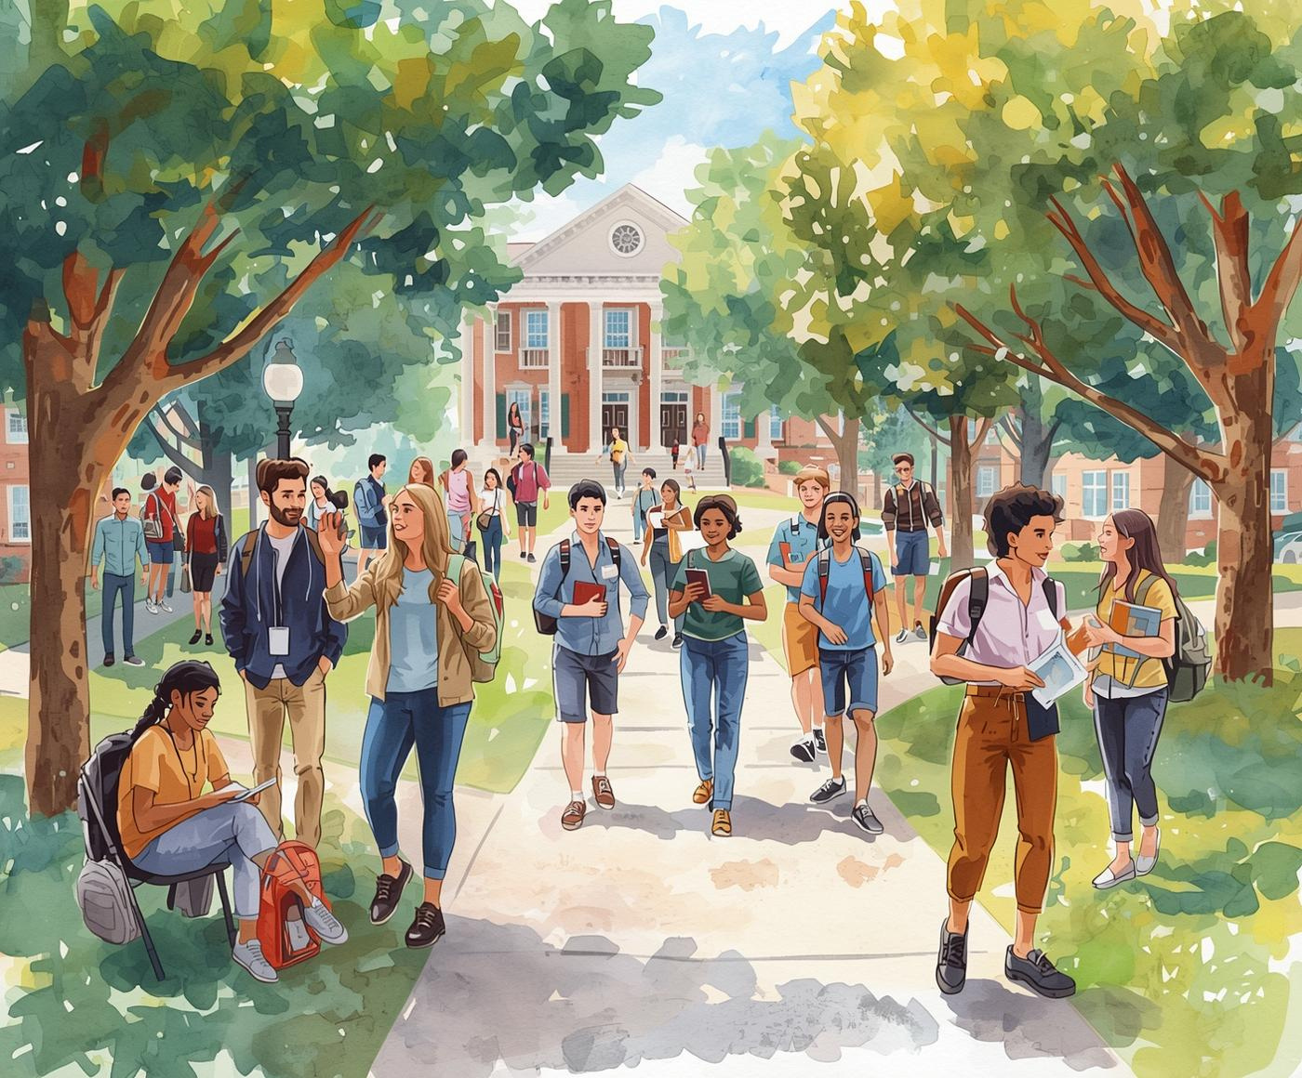
UNIVERSAL HUMAN VALUES
Amrithaa M
Esheshwari K
N Deepthi Nagaraj
PROFF. SHARATH B SHETTY

Slide 2

Ethical Dilemmas
Exploring the complexities of ethical decision-making in educational settings
In this presentation, we will delve into four compelling case studies that highlight ethical dilemmas faced by students on campus. Each scenario will help us understand the conflicting values and choices, encouraging thoughtful dialogue and reflection on integrity, respect, and inclusivity in our academic lives.

Slide 3
Case Study 1: Academic Integrity vs Peer Pressure

Slide 4

Conflict of Values
Friendship and Honesty: Navigating Rohit's Dilemma
1. What values are in conflict here?
Rohit finds himself in a challenging situation where friendship clashes with honesty. His best friend, desperate for help, asks for exam answers, forcing Rohit to weigh emotional loyalty against his moral responsibility. This dilemma prompts reflection on the values that underpin our relationships and academic integrity, highlighting the complexities of ethical decision-making.

Slide 5

Helping a Friend
Exploring the ethical boundaries of friendship and academic integrity
2. Is helping a friend always the right thing?
While friendships are vital, helping a friend in need must not compromise one’s values. It's crucial to understand that true support involves guiding each other towards honesty and integrity, rather than enabling unethical behavior. Engaging in an open dialogue about the importance of integrity fosters growth and responsibility among friends.

Slide 6

Upholding Integrity
Exploring Rohit's options without sacrificing his values
3. What could Rohit do without compromising integrity?
Rohit faces a challenging situation but can maintain his integrity. He could politely refuse his friend's request while encouraging transparency in their academic efforts. Offering emotional support, he can help his friend explore alternatives that uphold their shared values and foster a culture of honesty among peers.

Slide 7

Long-Term Effects
Understanding the consequences of academic dishonesty on students and peers
4. What are the long-term effects of dishonesty in academics?
Engaging in dishonesty undermines trust and integrity within the academic community. It can lead to severe academic penalties, damaging one's reputation and self-esteem. Furthermore, the long-term effects foster a culture of unfair advantages, impacting future opportunities and relationships with peers and educators alike.

Slide 8
Case Study 2: Dignity of Labor on Campus

Slide 9

The Dignity of Labor
Understanding the social biases that undermine respectful work environments
1. Why is dignity of labor often ignored?
The dignity of labor is often overlooked due to ingrained social biases and perceptions that prioritize certain roles over others. Many people fail to recognize the essential contributions of all workers, leading to a culture of invisibility and disregard for hard work. It is vital to cultivate an appreciation for every role on campus.

Slide 10

Should Students Intervene?
Engaging Respectfully with Campus Staff and Peers in Need
2. Should students interfere in such situations?
Engaging with situations involving dignity of labor calls for a balanced approach. Students should recognize when to step in but also respect established boundaries. Encouraging dialogue and raising awareness about the importance of labor can foster a supportive environment while acknowledging the autonomy of staff members.

Slide 11

Practicing Respect
Simple Daily Actions to Honor Labor on Campus
3. How can respect for labor be practiced daily on campus?
Respect for labor should be a daily practice on campus. Simple gestures like greeting staff, valuing their contributions, and maintaining cleanliness can foster a culture of appreciation. These actions not only uplift the morale of the labor community but also instill a sense of shared responsibility within the student body.

Slide 12

Constitutional Values
Exploring equality and respect in our community and beyond
4. What constitutional or human values are involved?
The dignity of labor emphasizes equality for all individuals, regardless of their role or status on campus. Respect for every person's contribution fosters an inclusive environment where everyone feels valued. Upholding these principles is essential to create a supportive community that honors the worth and rights of every individual.

Slide 13
Case Study 3: Inclusivity and Teamwork

Slide 14

Discrimination Defined
Understanding the subtle nuances of exclusion and bias in education
1. Is this a form of discrimination? Why or why not?
Discrimination occurs when individuals are treated unfairly due to personal characteristics. In this scenario, quiet exclusion based on language and background signifies a form of discrimination. It undermines the principles of equality and respect, fostering an environment where all students should feel valued and included in academic settings.

Slide 15

Inclusivity Boosts Performance
Embracing diverse perspectives enhances collaboration and innovation in teams
2. How does inclusivity improve team performance?
Inclusivity fosters a dynamic environment where diverse ideas thrive. By welcoming different viewpoints, teams can discover creative solutions and improve problem-solving capabilities. Research shows that inclusive teams achieve better outcomes, as members feel valued and engaged, which leads to increased productivity and overall success in group projects.

Slide 16

Values in Group Work
Encouraging Respect and Fairness for Successful Collaboration
3. What values should guide group work in college?
In group work, it's crucial to prioritize respect and fairness. By valuing diverse opinions and treating each member equally, teams foster an inclusive environment. This approach not only enhances collaboration but also leads to richer discussions and better outcomes, ensuring that everyone's contributions are recognized and appreciated.

Slide 17

Supporting the Student
Encouraging Inclusivity and Collaboration within the Team
4. How could the team support the student?
To foster an inclusive environment, the team can take several meaningful actions. These include extending invitations to group activities, providing language support, and actively encouraging participation. By creating a welcoming atmosphere, the team not only uplifts the rural student but also enriches the group's overall dynamics and collective success.

Slide 18
Case Study 4: Short-Term Gain vs Long-Term Values

Slide 19

Compromised Values
Exploring the ethical landscape of integrity and honesty
1. What values are being compromised?
In today's academic environment, integrity and honesty stand as foundational values. When faced with financial temptation, students often grapple with the pressures that compromise these principles. This scenario raises critical questions about character and the importance of upholding ethical standards, emphasizing the need for personal responsibility in our choices.

Slide 20

Financial Need Justification
Evaluating the ethics of financial necessity in decision making
2. Is financial need a valid justification?
Financial need can pose a significant ethical dilemma for students faced with tough choices. While financial pressure may tempt individuals to compromise their values, it's crucial to critically assess whether such justifications align with long-term integrity. Exploring alternative support systems can lead to more ethical resolutions without sacrificing personal morals.

Slide 21

Impact on Character
Understanding the long-term consequences of poor ethical decisions in students
3. How does such behavior affect character development?
Engaging in dishonest behavior can severely undermine a student's character development. These actions can lead to decreased trustworthiness, diminished self-respect, and create a pattern of poor decision-making. Over time, the choices made in academia may negatively influence a student's future relationships and opportunities, highlighting the importance of integrity.

Slide 22

Alternatives to Consider
Exploring options for help and support in challenging situations
4. What alternatives could the student consider?
Students facing financial temptation can explore various supportive alternatives. They might seek financial aid from the institution, participate in time management workshops, or apply for scholarships. Developing a strong work ethic and seeking honest guidance can foster both personal integrity and academic success, ensuring long-term benefits while navigating challenges.

Slide 23

Conclusion
“Doing the right thing matters, even when it’s not the easy thing.”
VALUES
This quote reflects how ethical decisions demand honesty and responsibility, reminding us that true success comes from standing by our values, not from taking shortcuts.
These case studies show that ethical choices often test our courage and values. While the easier option may bring temporary comfort, choosing what is right builds integrity, respect, and long-term trust in both academic and professional life.

Slide 24
THANK YOU

